Slide 1
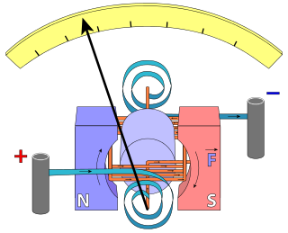
Needle
(Pointer)
N
S
Return Spring
Coil
Bearings
(Jewels)
Magnet Assembly

